Slide 1
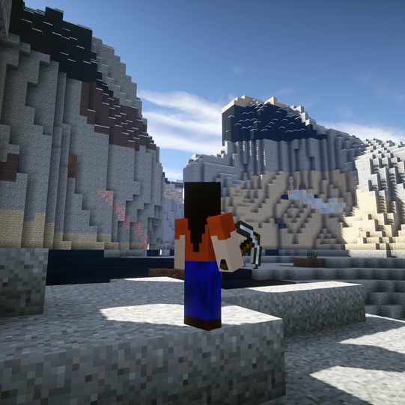
3 Rs TO REDUCE WASTE
Teaching about raw materials through Minecraft
Available on www.bettergeoedu.com

Slide 2
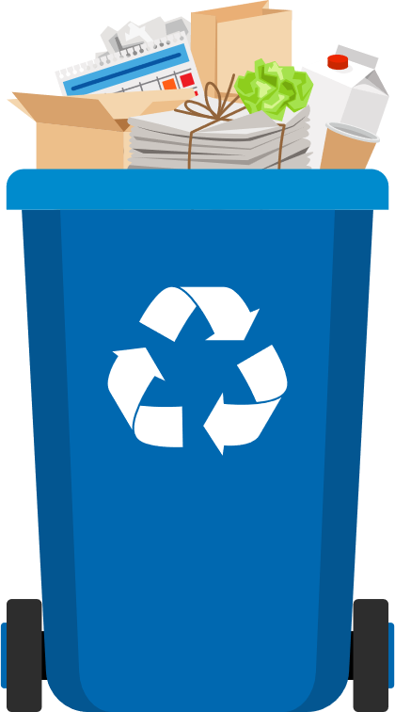
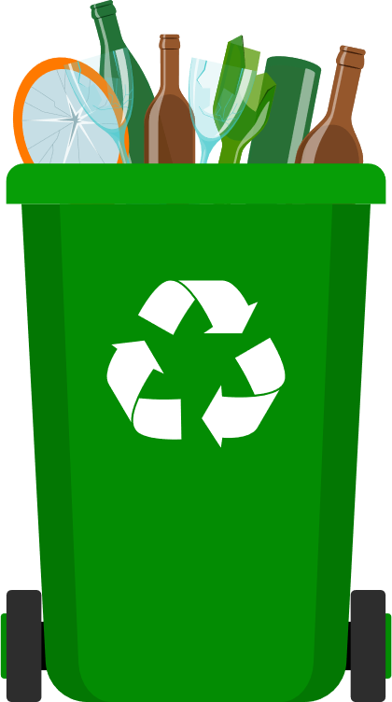
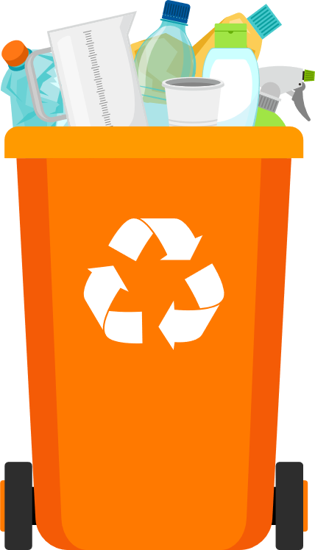
WASTE MANAGEMENT?
Organic waste
Paper
Glass
Plastic

Slide 3
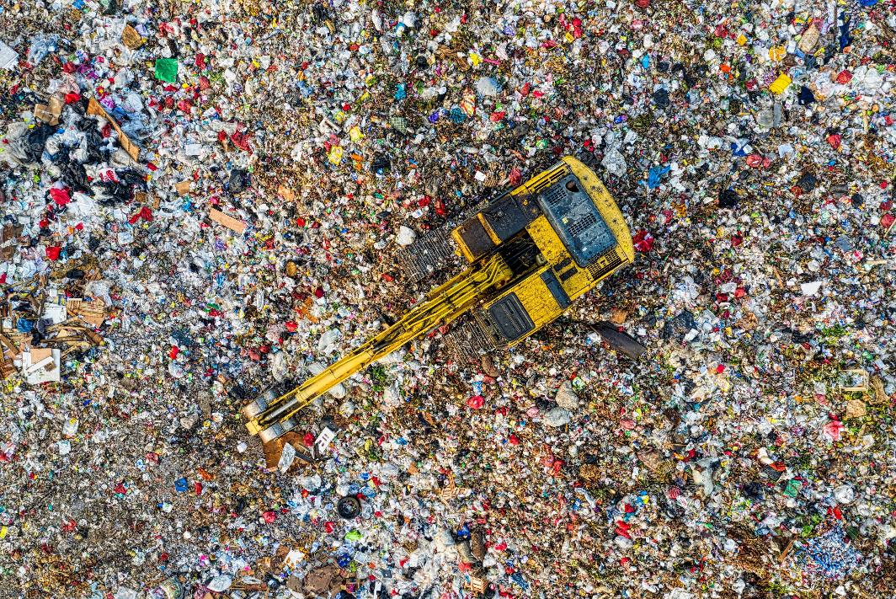
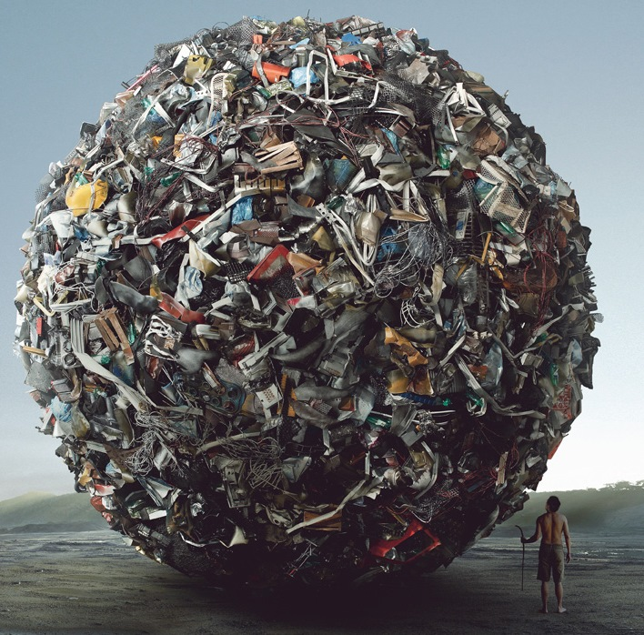
TOO MUCH WASTE
PORABA SUROVIN

Slide 4
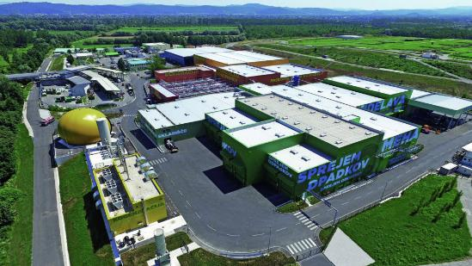
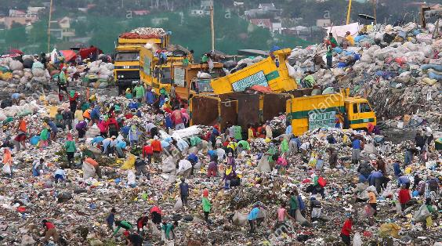
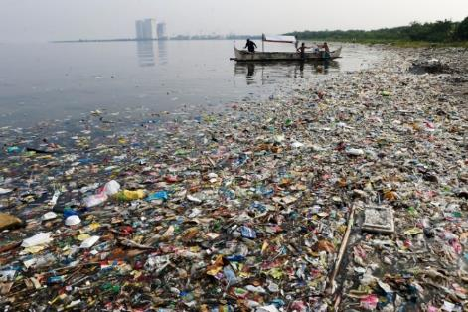
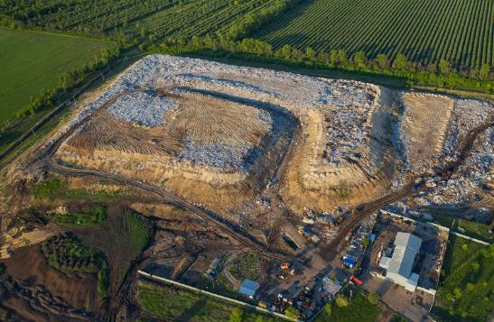
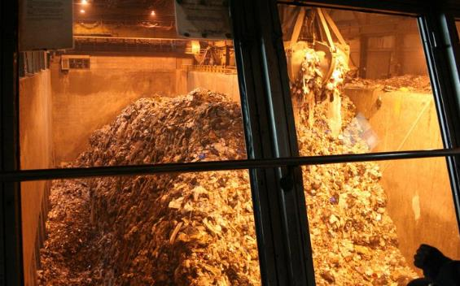
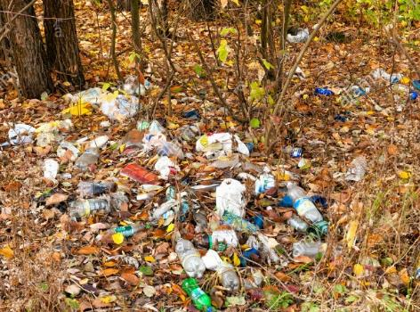
WHERE DOES THE WASTE GO?

Slide 5
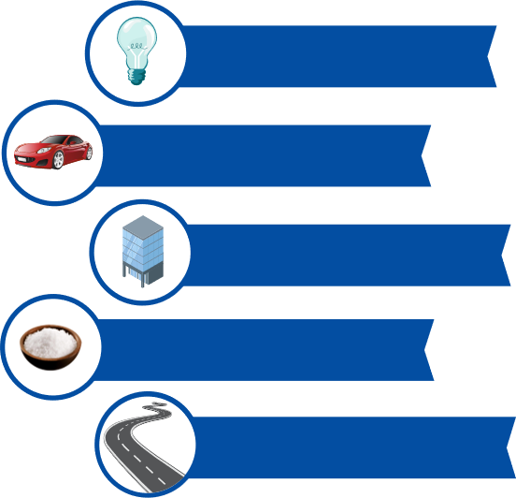
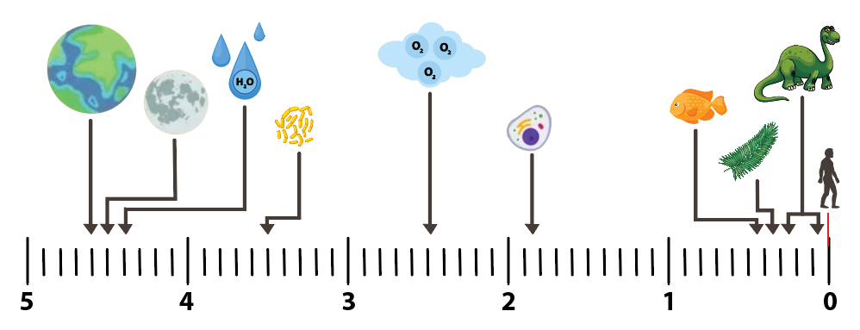
HOW MUCH RAW MATERIALS DO WE CONSUME?
PORABA SUROVIN
  CONSUMPTION OF RAW MATERIALS IN THE LIFE OF ONE PERSON
EARTH HISTORY (4,6 billions years)
MODERN HUMAN (200 thousand years)
  COPPER ∼ half a ton
  ALUMINIUN ∼ 1 ton and a half
  IRON ∼ 15 tons
  SALT ∼ 13 tons
Billions of years ago
  CEMENT ∼ 560 tons
Source: USGS, 2018

Slide 6


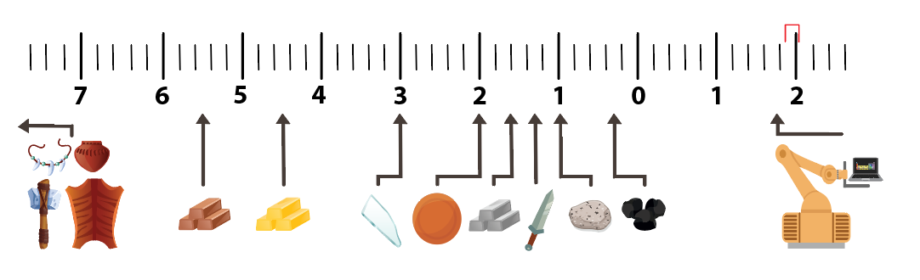
HOW MUCH RAW MATERIALS DO WE CONSUME?
PORABA SUROVIN
In the last 150 years, we have consumed almost half of the currently known resources on Earth
Thousand of years ago
The present
Rocks, lather, pottery
Copper
Gold
Glass
Bronze
Iron
Steel
Concrete
Coal
Start of industrialization and the rapid discovery of new materials and elements

Slide 7
IS RECYCLING ENOUGH?
  PAST
  PRESENT
  FUTURE
  WHY NOT:
  Not everything can be recycled
  Raw materials assembled in devices
  Limited number of recycling (recycling losses)
  Poorer quality of recycled raw materials
  It is not profitable

Slide 8
IS RECYCLING ENOUGH?
  LINEAR ECONOMY
  RECYCLING
  ECONOMY
  CIRCULAR ECONOMY
IT IS NOT ENOUGH!
HOW CAN YOU CONTRIBUTE FOR THE FUTURE?

Slide 9

HOW CAN YOU CONTRIBUTE?
3 R
Reduce
Reuse
Recycle
Energy from waste
Landfill
HIERARCHY OF WASTE MANAGEMENT

Slide 10

WASTE MANAGEMENT
3 R
REDUCE OR PREVENT WASTE

Slide 11
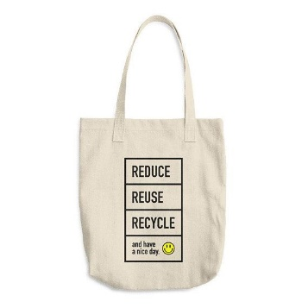


WASTE MANAGEMENT
REDUCE OR PREVENT WASTE
What this mean? → Reduce the amount of waste you produce every day
Use reusable products (glass bottles, cloth bags).
Rent or share certain products (tools, furniture, cars).
Buy only what you really need.
Buy products with less packaging or those that are recyclable.
Use products as long as possible (take good care of products and make repairs).
Print fewer things.

Slide 12

WASTE MANAGEMENT
3 R
REUSE

Slide 13
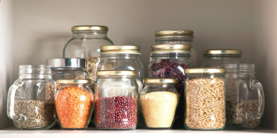
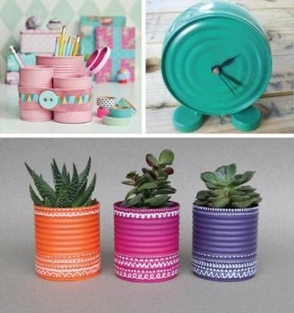

WASTE MANAGEMENT
REUSE WASTE
What this mean? → Find a new application for the product you intended to throw away
Use glass / plastic packaging for storage.
Use old clothes to clean.
Donate things you no longer need or want to replace (clothes, phone…).
Reuse products for another purpose (jeans bag, old paper, bottles…).

Slide 14

WASTE MANAGEMENT
3 R
RECYCLE

Slide 15
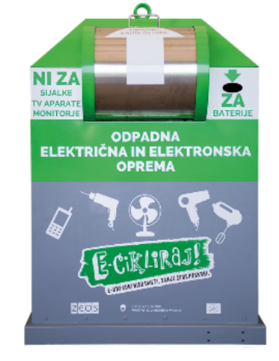
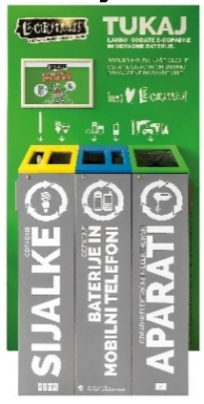
WASTE MANAGEMENT
RECYCLE
What this mean? → Ensure that new products can be made from the product
Sort waste into the correct bins
Proper disposal of all other waste that does not end up in the regular waste bins:
  Waste electrical and electronic equipment (WEEE) (electronics, batteries, lamps, kitchen appliances)
  Bulky waste
  Hazardous waste

Slide 16

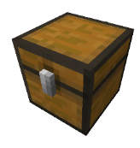









WASTE MANAGEMENT IN MINECRAFT

Slide 17
WASTE MANAGEMENT

Slide 18
#BetterGeoEdu
Supported by:

