Slide 1
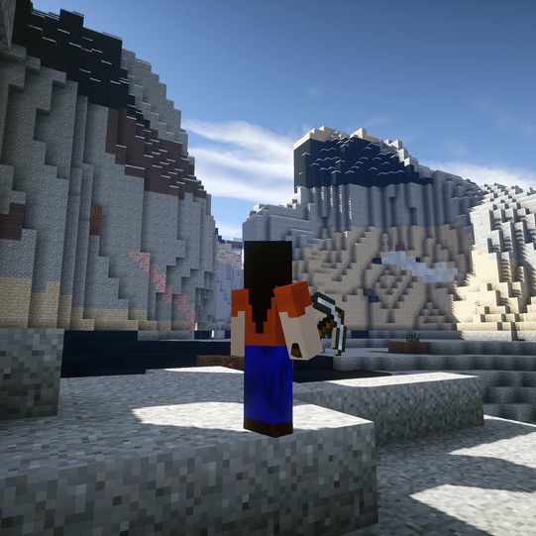

BETTERGEO HUNT
Teach about Raw Materials with Minecraft
Available on www.bettergeoedu.com

Slide 2

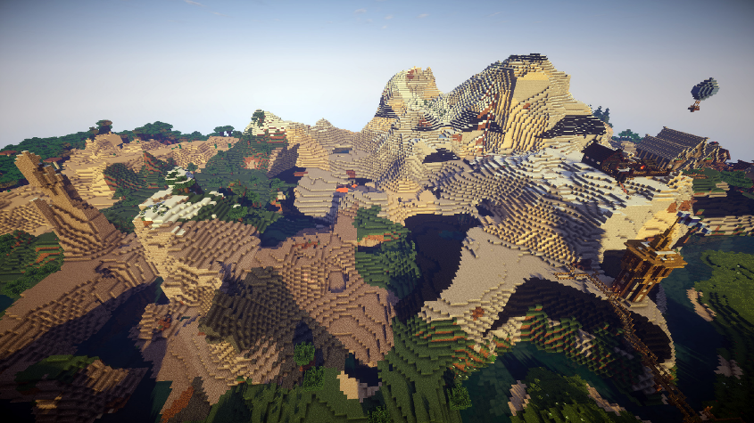
Minecraft is one of the most popular game in the world (100+M players).
Players explore an open world made of blocks.
Blocks in the world can by mined to gain different materials.
Different materials can then be combined to craft new items!
Click here to discover mod BetterGeo!

Slide 3


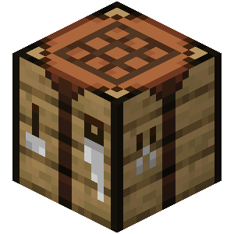
WHAT IS A RAW MATERIAL?
The materials used to craft in Minecraft are called raw materials in real life.
If raw materials do not grow on trees, where do they come from?
Raw materials come from nature; they are natural resources.
Raw materials are used in the production of almost all everyday objects.
How do we get raw materials in Minecraft? What about in real life?

Slide 4
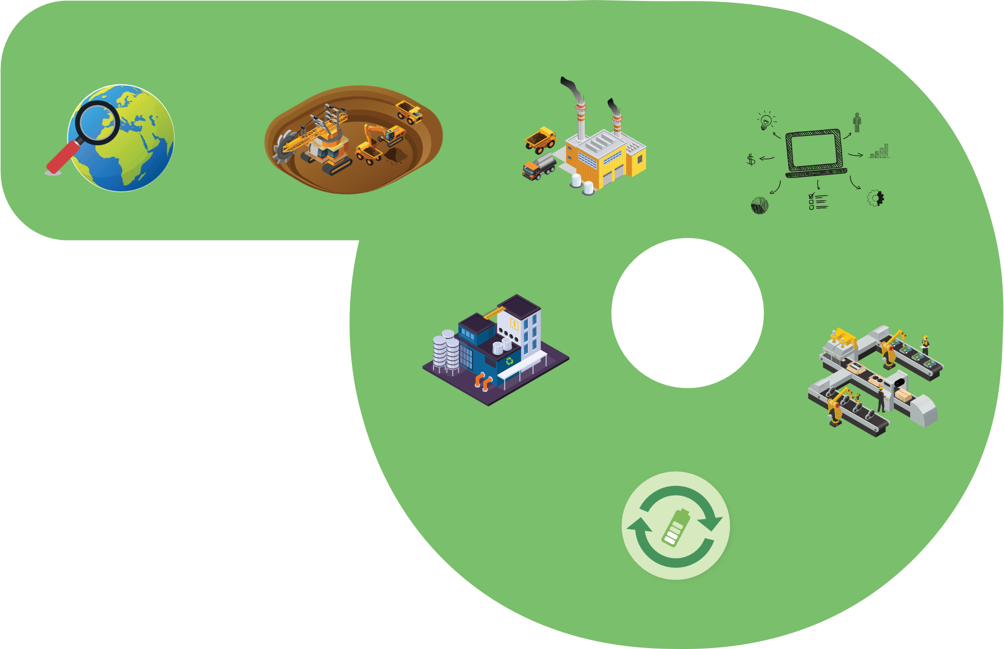


WHAT IS CIRCULAR PATH OF RAW MATERIALS?
EXPLORATION
MINING
PROCESSING
DESIGN
RECYCLING
PRODUCTION
How are raw materials linked to this circular path?
USE, REUSE

Slide 5
ORIENTATION
If we don't want to get lost as we walk around the world in Minecraft, we need to have a good orientation. What does ORIENTATION mean?
ORIENTATION means to determine the position of a point or the direction of movement with respect to the cardinal directions of the sky and objects in the landscape.
We know: GEOGRAPHICAL and TOPOGRAPHIC ORIENTATION.
→
→
Determining the cardinal directions of the sky with a compass, with the help of stars, the sun, signs in the field, etc.
Determining the position of the observer in relation to objects and relief in the surroundings.
When are you oriented in space?

Slide 6
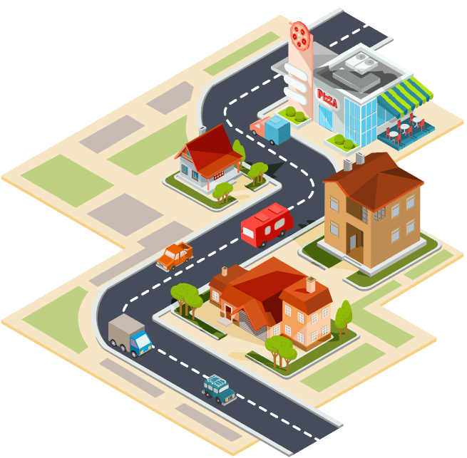
WHEN ARE YOU ORIENTATED?
Think about the space between your home and school. Are you oriented in this space?
We are oriented when we know where we are and where we need to go to reach a certain goal. This means that we orientate ourselves in a certain space, object, place.
What are the cardinal directions of the sky and how do we determine them?

Slide 7
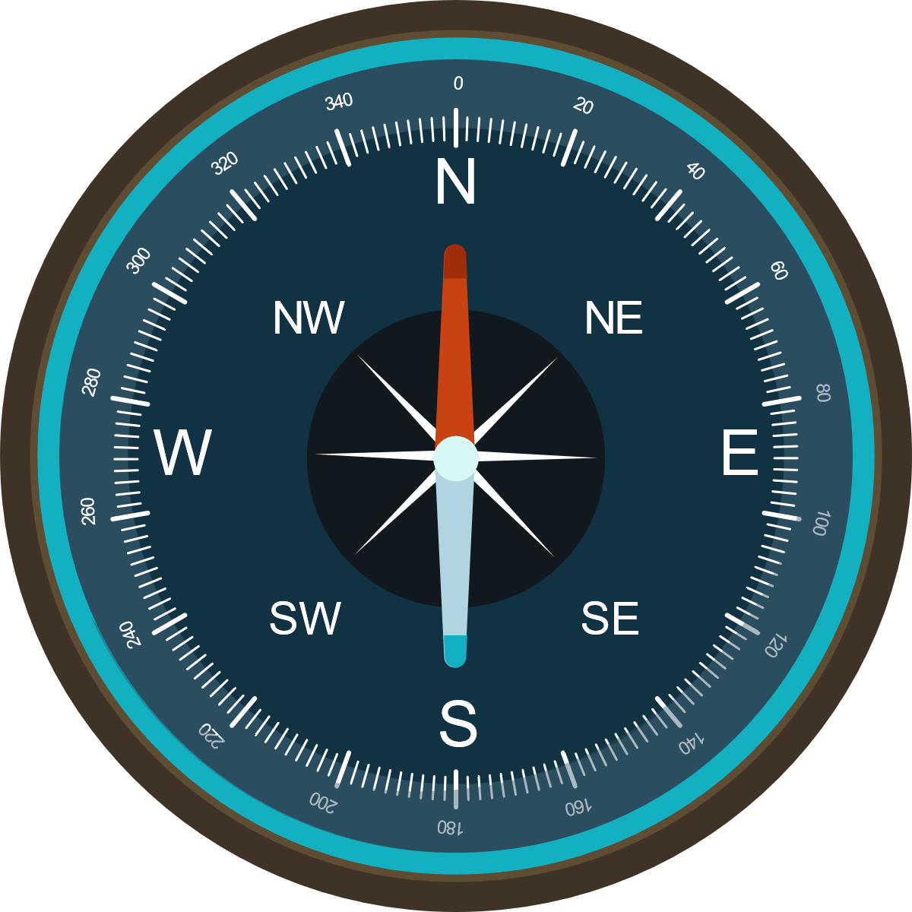
COMPASS AND THE DIRECTIONS OF THE SKY
We use the COMPASS to determine the cardinal directions of the sky. The compass has a magnetic needle that always faces the magnetic north.
CARDINAL DIRECTIONS ARE:
Attention!
The capital letters on compass are meant for the English names of the cardinal directions of the sky and may not match the names in the different languages.
N → NORTH
NW → NORTHWEST
NE → NORTHEAST
W → WEST
E → EAST
SW → SOUTHWEST
SE → SOUTHEAST
S → SOUTH

Slide 8
ORIENTATION TASK WITH A GRID
In front of you, you have a grid with marked sides of the sky: north (N), south (S), east (E), west (W).
Start drawing with the red pen at the red dot marked on the grid.
Drawing instructions: 1 N means go 1 step north, 2 N means go 2 steps north, etc.; 1 SE means go 1 step to the southeast etc.
Instruction: 5 N –1 W –2 NE –5 E –2 SE –1 W –5 S – 2 W –3 N –2 W –3 S –3 W
N
W
E
S

Slide 9
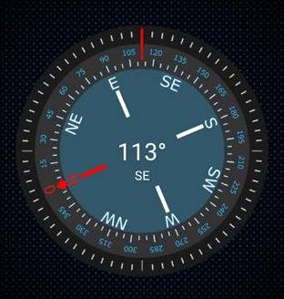
TASK WITH A COMPASS
Open the Compass Galaxy app and hold the tablet in front of you in a horizontal position. To determine north, turn until the red needle (N) aligns with the red mark.
Now you are looking north, and you are oriented in space.
Look at what is in the classroom to the north, south, west and east.
On which direction of the sky are the door, board, and windows located?

Slide 10
A MAP
Maps can also be a great help in orienteering. What is a map?
The map is a scaled-down and simplified view of the Earth's surface on a flat surface.
All maps, charts and sketches are oriented so, that there is always NORTH at the top of the map. Therefore, we can see on a map which country or place lies north, south, east, or west of our standpoint.
The MAP must contain:
TITLE
LEGEND
SCALE
MARKED DIRECTIONS OF THE SKY
DATE / YEAR OF ISSUE

Slide 11
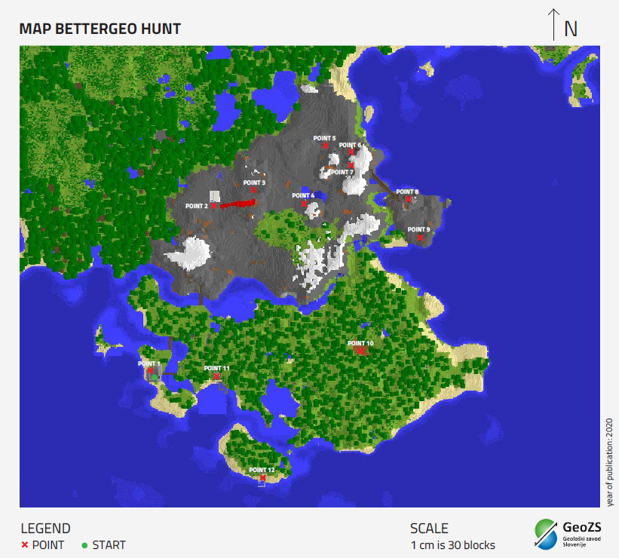
ORIENTATION IN MINECRAFT - BETTERGEO HUNT
Does the map contain all the components?
INSTRUCTIONS:
Take a good look at the worksheet.
Visit all the points in the ready BetterGeo world as you see them on the map. Help yourself with the acquired knowledge of orientation and the compass.
Follow the instructions at each point! In the end, you will answer three questions related to points and find the treasure!

Slide 12
CIRCULAR PATH OF RAW MATERIALS
EXPLORATION
MINING
PROCESSING
DESIGN
RECYCLING
PRODUCTION
Where do we get raw materials?
How can we reduce the use of raw materials?
Why is circular path of raw materials important for our lives?
USE, REUSE

Slide 13
#BetterGeoEdu
Supported by:

