Slide 1
LEGO MINING
Teach about Raw Materials with Minecraft
Available on www.bettergeoedu.com

Slide 2
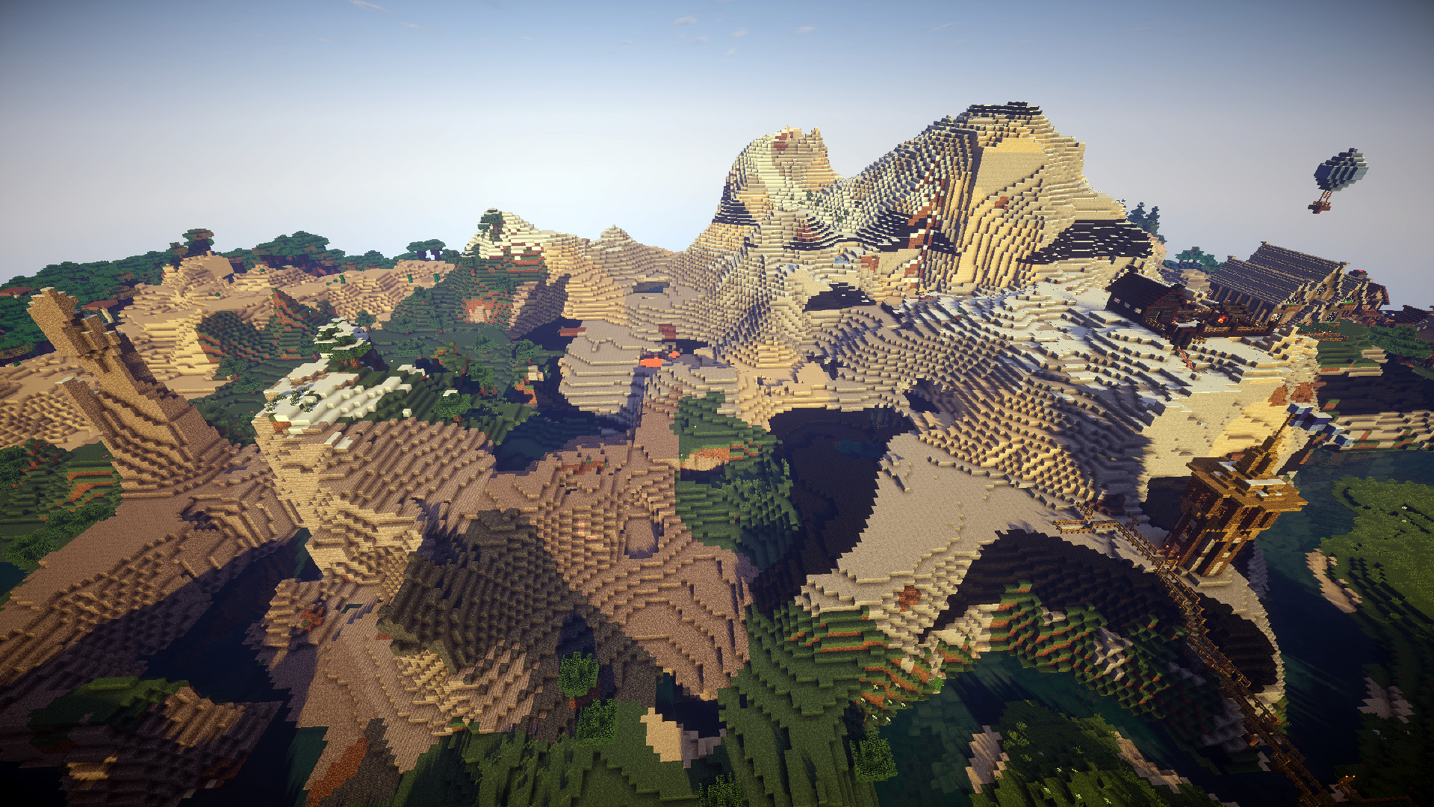
Minecraft is one of the most popular game in the world (100+M players)
Players explore an open world made of blocks
Blocks in the world can by mined to gain different materials
Different materials can then be combined to craft new items!
Click here to discover mod BetterGeo!

Slide 3
The materials used to craft in Minecraft are called raw materials in real life.
What is a raw material?
If raw materials do not grow on trees, where do they come from?
Raw materials come from nature, they are natural resources
It is a material used in the production of objects
How do we get raw materials in Minecraft? What about in real life?

Slide 4
EXPLORATION
Rock
Rock Forming Minerals
What is a rock made from?

Slide 5
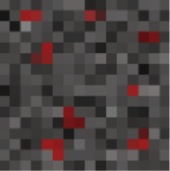
EXPLORATION
+
=
Ore
mineral
+
Rock from Rock Forming Minerals
=
Ore
What is an ore?

Slide 6
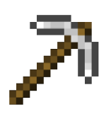
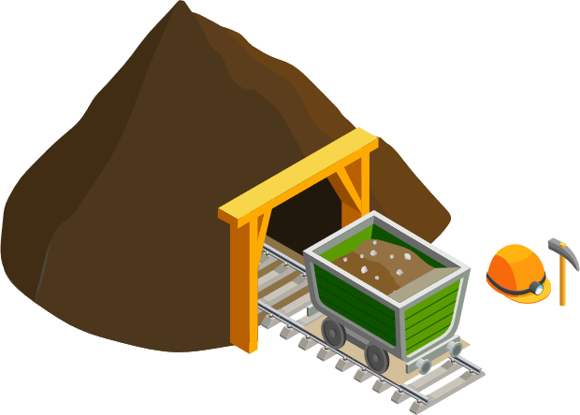
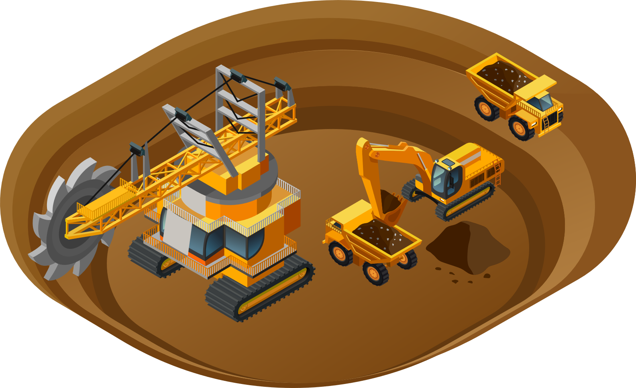
MINING
Click here to find out how mining works in Minecraft.

Slide 7
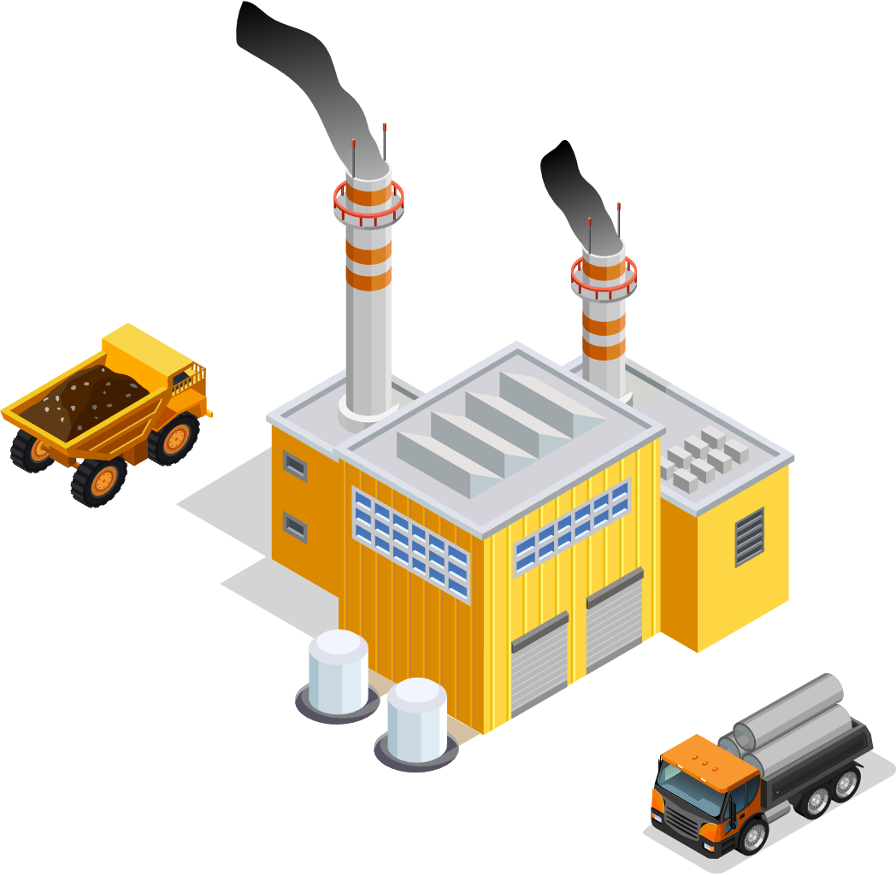
PROCESSING
14 others and 2 red
= 1/8
= 12,5%
= 1€
12 others and 4 red
= 1/4
= 25%
= 2€
8 others and 8 red
= 1/2
= 50%
= 4€
There are different proportions of ore minerals in the ore. When is it worth to mine it?

Slide 8
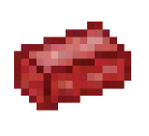
PROCESSING
Primary
raw material
Secondary
raw material
Click here to learn where we use raw materials.

Slide 9
#BetterGeoEdu
Supported by:

